Slide 1

Fundamentals of Software Engineering
Lecture 3: Software application types and Software Processes

Slide 2
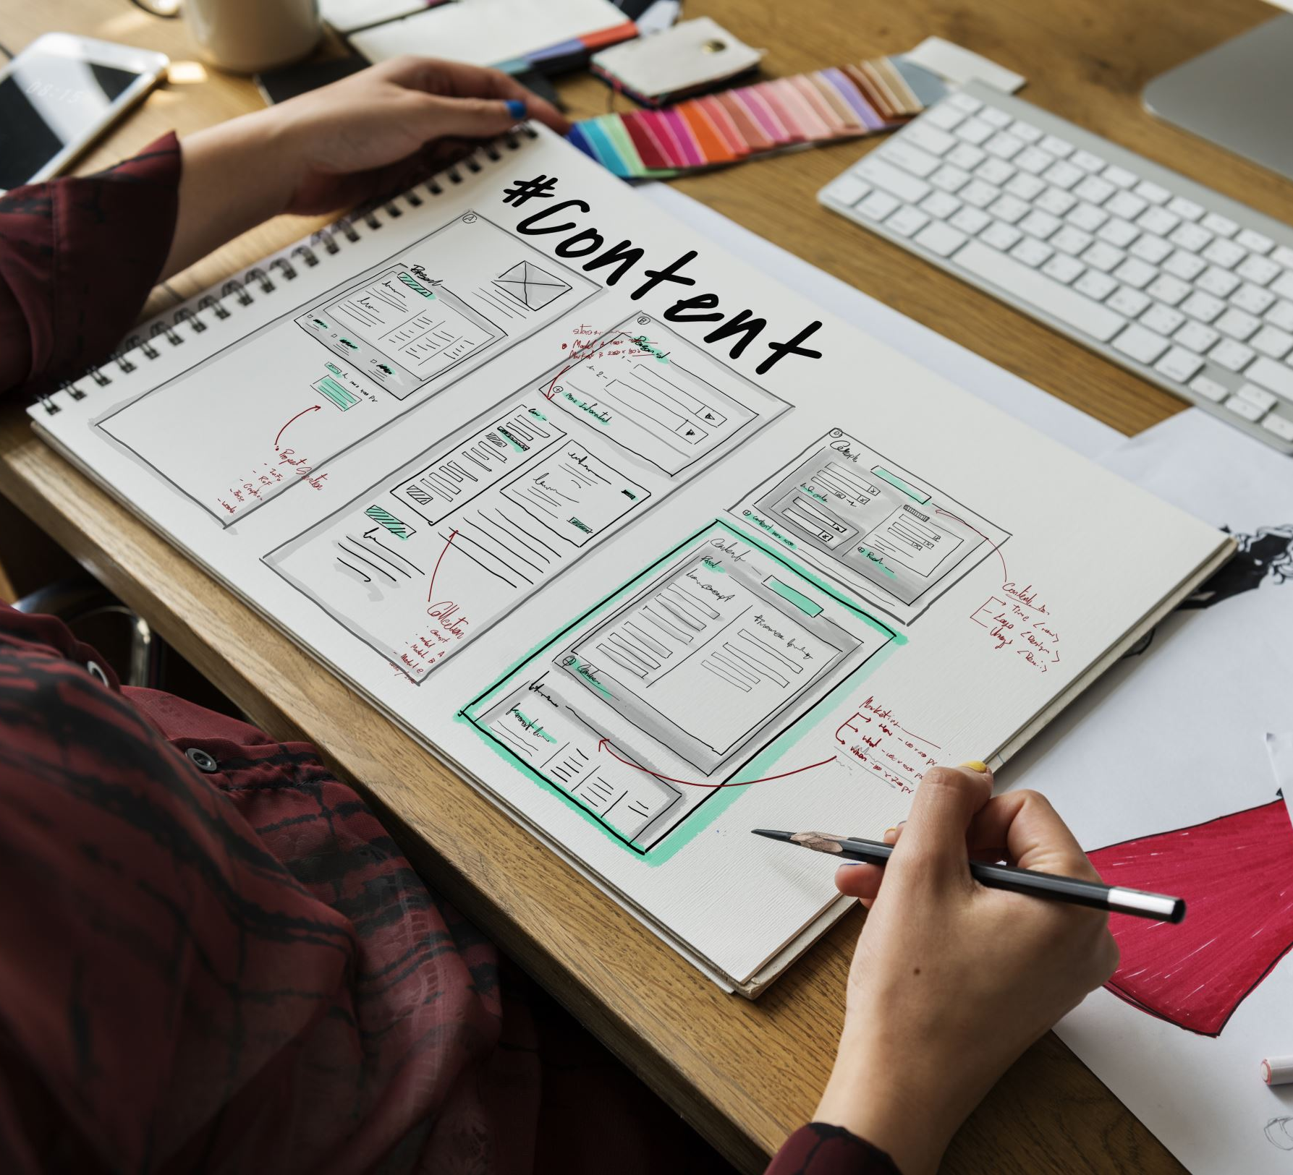
Types of Software Application

Slide 3
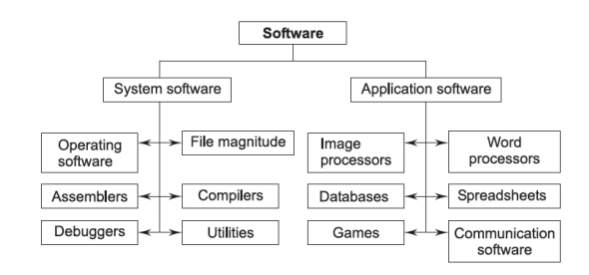
Types of Software
Notes:
The main difference between system software and application software is that system software are primarily designed to manage system-based resources and operations and acts as an interface between application software and computer hardware, while application software are primarily designed to help users perform ...

Slide 4
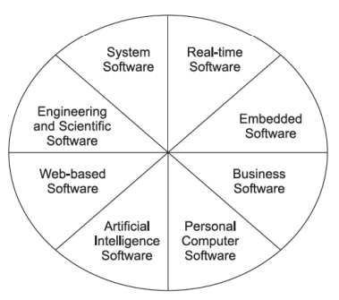
Software Application Types
Notes:
AI software type: Activate the service to send SMS on Entry and Exit of Motorway, to detects frauds etc.
Business Software: SAP, OracleApps, PeachTree (accounting)

Slide 5
Software Application types
Stand-alone applications
These are application systems that run on a local computer, such as a PC. do not need to be connected to a network. MS Office, Compiler etc.
Interactive transaction-based applications
Applications that execute on a remote computer and are accessed by users from their own PCs. web applications such as e-commerce applications.
Embedded control systems
These are software control systems that control and manage hardware devices. Mouse, Network drivers etc.

Slide 6
Application types
Batch processing systems
These are business systems that are designed to process data in large batches. E.g Credit card companies process bill, generate payroll, generate SMS for clients.
Entertainment systems
Media players etc.
Systems for modeling and simulation
These are systems that are developed by scientists and engineers to model physical processes or situations, which include many, separate, interacting objects. CASE, System Arch, Visio etc.

Slide 7
Application types
Data collection systems
These are systems that collect data from their environment using a set of sensors and send that data to other systems for processing. e.g. RTU in Supervisory Control and Data Acquisition (SCADA) systems
Systems of systems
These are systems that are composed of a number of other software systems. e.g. Electric/power grid systems
Notes:
Many industrial organizations rely on a Supervisory Control and Data Acquisition (SCADA) system. It helps operators access actionable data and manage equipment. SCADA is a powerful control system that is designed to collect, analyze, and visualize data from industrial equipment
An RTU (remote terminal unit) interfaces the sensors to the SCADA Master Station or Communications Network. RTUs provide telemetry information and some local control facilities.

Slide 8
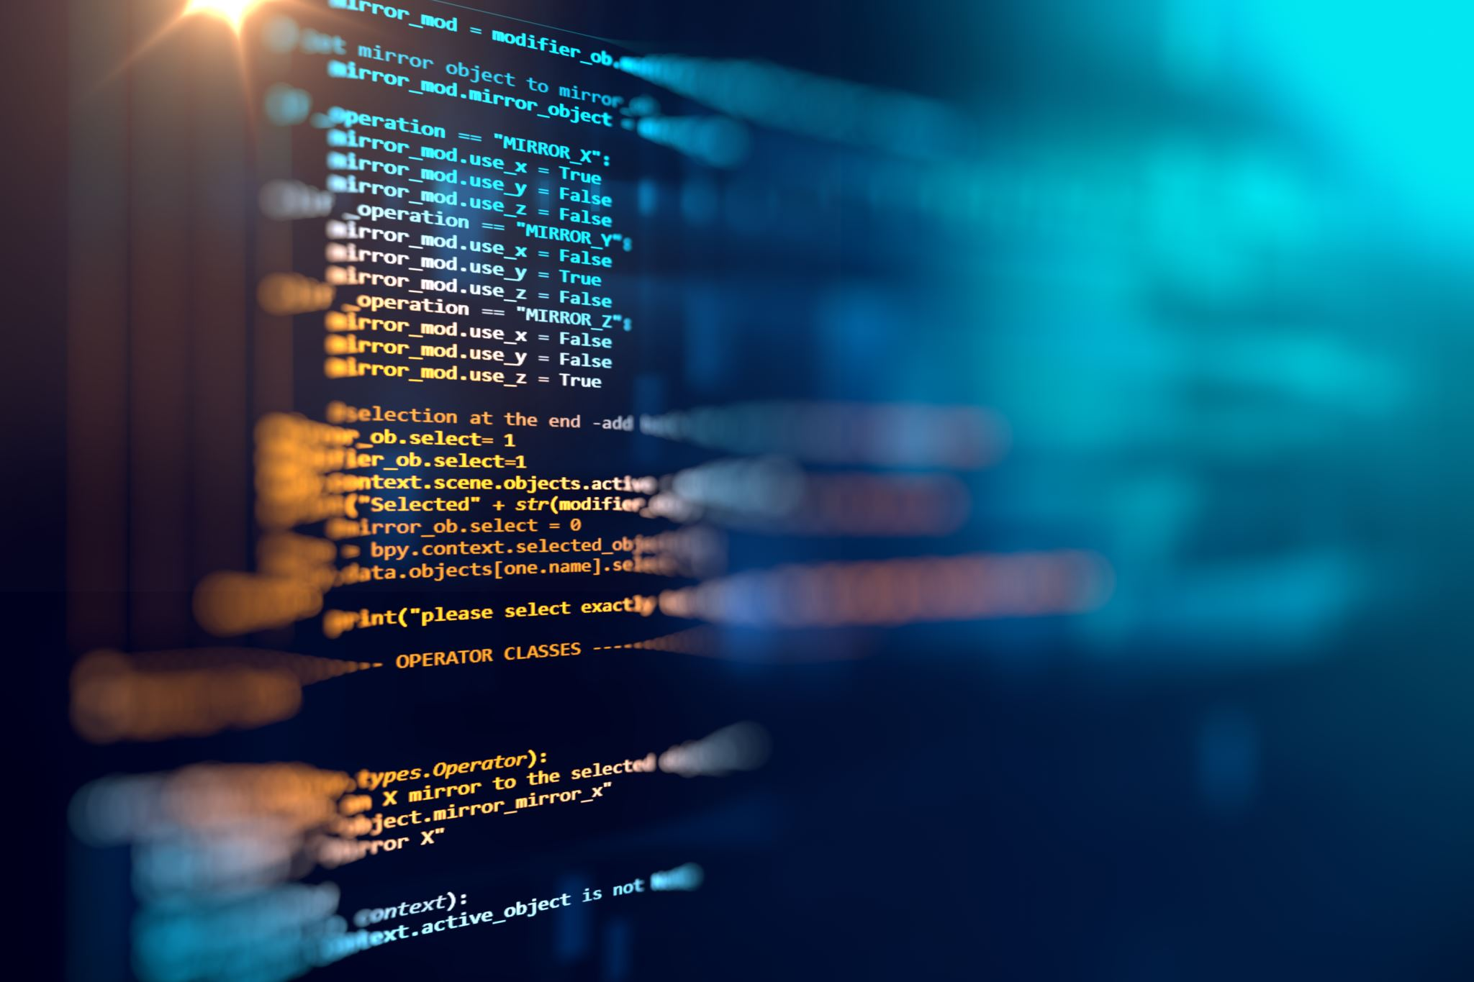
Software Processes

Slide 9
What is a software process?
A set of activities whose goal is the development or evolution of software
Generic activities in all software processes are:
Specification - what the system should do and its development constraints
Design and Development - production of the software system
Validation - checking that the software is what the customer wants
Evolution - changing the software in response to changing demands
Notes:
Stackholders: Client/ customer, End users, Managers
Software Process or LC: Set of activities of tasks, to develop software application. All activities are managed under timelines, budget and resources called Milestones.
Generic activities are Req, Spec, Design (System & Software), Development, validations and evolutions.

Slide 10

Software Process
Fundamental Assumption:
Good processes lead to good software
Good processes reduce risk
Good processes enhance visibility
Good processes enable teamwork
Notes:
UI shows status: Yes or Not, may have several assumptions, visibility in terms of understanding is not clear
Data saved in two tables may increase risks and increase invisibility.

Slide 11
Variety of Software Processes
Software products are very varied...
Therefore, there is no standard process for all software engineering projects
BUT successful software development projects all need to address similar issues.
This creates a number of process steps that should be part of all software projects.

Slide 12
What is a software process model?
A simplified representation of a software process, presented from a specific perspective
Examples of process perspectives are
Workflow perspective - sequence of activities
Data-flow perspective - information flow
Role/action perspective - who does what
Generic process models
•Waterfall
•Evolutionary development
•Formal transformation
•Integration from reusable components

Slide 13
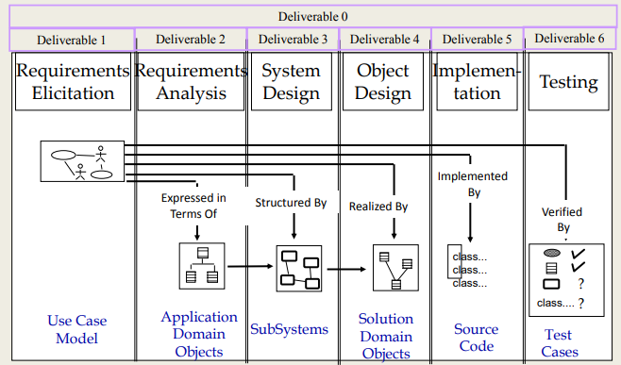
Software Lifecycle Activities
Notes:
Software Process or LC: Set of activities of tasks, to develop software application. All activities are managed under timelines, budget and resources called Milestones.
Generic activities are Req, Spec, Design (System & Software), Development, validations and evolutions.

Slide 14
Basic Process Steps in all Software Development
Feasibility and planning
Requirements
System and program design
Implementation
Acceptance and release
Operation and maintenance
It is essential to distinguish among these process steps and to be clear which you are are doing at any given moment.
These steps may be repeated
many times during the
development cycle.
Notes:
SDLC (Micro Project) can be software system used to manage tokens/ tickets and financial modules works under Macro Project Metro Bus Service

Slide 15
Quality Control Steps in all Software Development
Validating the requirements
Validating the system and program design
Usability testing
Program testing
Acceptance testing
Bug fixing and maintenance
Some of these steps will be repeated many times during the
life of the system

Slide 16
Process Step: Feasibility
A feasibility study precedes the decision to begin a project.
• What is the scope of the proposed project?
• Is the project technically feasible?
• What are the projected benefits?
• What are the costs,?
• Are the resources available?
• What are the risks and how can they be managed?
A feasibility study leads to a decision: go or no-­‐go.

Slide 17
Process Step: Requirements
Requirements define the function of the system from the client's viewpoint.
The requirements establish the system's functionality, constraints, and goals by consultation with the client, customers, and users.
They must be developed in a manner that is understandable by both the client and the development staff.

Slide 18
Process Step: Requirements
This step is sometimes divided into:
• Requirements analysis
• Requirements definition
• Requirements specification
(SRS document : The system shall allow a student to borrow a maximum of 3 books for 14 days.)
The requirements may be developed in a self-­‐contained study, or may emerge incrementally.
Failure to agree on the requirements and define them adequately is one of the biggest cause of software projects failing.

Slide 19
Process Step: System Design
Design describes the system from the software developers' viewpoint
System design:
Establish a system architecture, both hardware and software, that matches the requirements
Program design:
Represent the software functions in a form that can be transformed into one or more executable programs
Preliminary user testing is often carried out as part of the design step.

Slide 20
Process Step: Implementation
Implementation (coding)
The software design is realized as a set of programs or program units.
These software components may be wriben by the development team, acquired from elsewhere, or modified from existing components.
Program testing
Program testing by the development staff is an integral part of implementation.
Individual components are tested against the design.
The components are integrated and tested against the design as a complete system.

Slide 21
Categories of Testing
The term “testing” is used in several different contexts, which are easily confused:
User testing
Versions of the user interface are tested by users. Their experience may
lead to changes in the requirements or the design.
Program testing
The development team tests components individually (unit testing) or in
combination (system testing) against the design to find bugs, etc.
Acceptance testing
The client tests the final version of the system or parts of the system against the requirements.

Slide 22
Process Step: Acceptance and Release
Acceptance testing
The system is tested against the requirements by the client, often with selected customers and users.
Delivery and release
After successful acceptance testing, the system is delivered to the client and released into production or marketed to customers.

Slide 23
Process Step: Operation and Maintenance
Operation:
The system is put into practical use.
Maintenance:
Errors and problems are identified and fixed.
Evolution:
The system evolves over time as requirements change, to add new functions, or adapt to a changing technical environment.
Phase out:
The system is withdrawn from service.
This is sometimes called the Software Life Cycle

Slide 24
Sequence of Process Steps
Every software project will include these basic processes, in some shape or form, but:
• The steps may be formal or informal
• The steps may be carried out in various sequences

Slide 25
Sequence of Process Steps
Major alternatives
In this course, we will look at three categories of software development processes:
Sequential:
As far as possible, complete each process step before beginning the next. Waterfall model.
Iterative:
Go quickly through all process steps to create a rough system, then repeat them to improve the system. Iterative refinement.
Incremental:
A variant of iterative refinement in which small increments of software are placed in production (sprints). Agile development.

Slide 26
Heavyweight and Lightweight Software Development
In a heavyweight process, the development team works through the process steps slowly and systematically, with the aim of fully completing each process step and deliverables for that step that will need minimal changes and revision.
Example: Modified Waterfall Model
In a lightweight process, the development team releases working software in small increments, and develops the plans incrementally, based on experience. Each increment includes all the process steps. There is an expectation that changes will be made based on experience.
Example: Agile Software Development

Slide 27
Deliverables
Deliverables
A deliverable is some work product that is delivered to the client.
• In a heavyweight process, each process step creates a deliverable, usually documentation, e.g., a requirements specification.
• In a lightweight process, the deliverables are incremental working code, with minimal supporting documentation.

Slide 28


